Slide 1


HANA Native Development
Version 1.0, July 2015
Author Ross Hightower
Product SAP HANA
Level Beginner
January 8, 2018
Focus
An introduction to application development on HANA.
Public

Slide 2
Introduction to HANA Development Table of Content
HANA Native Development
Development Environments

Slide 3
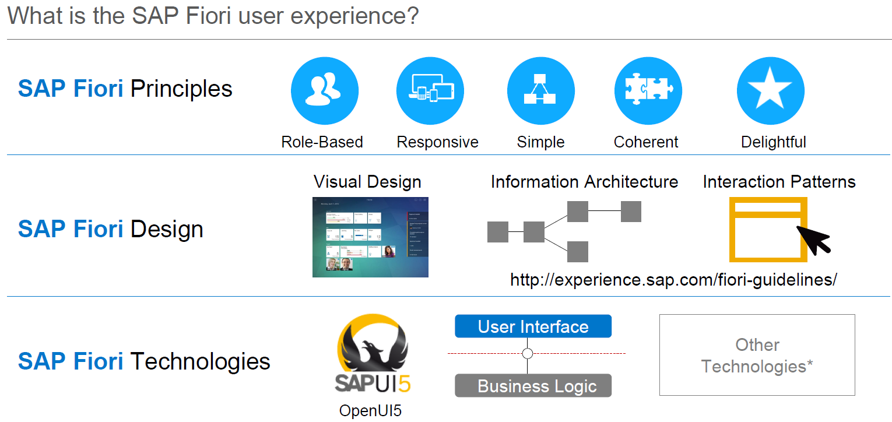

Slide 4
HANA Native Development

Slide 5
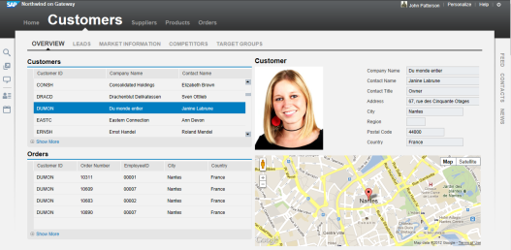



HANA Application Development Platform
Traditional 3-Tier
Database and App server separate
Control and calculation logic in the application
Native HANA
Light weight XS server part of HANA
Control logic in application
Calculation logic in database
Faster calculations in a robust environment
Less data transmitted over slow links
Lighter weight, simpler HTML based applications
Application Server
Application
XS Services
Application
DBMS
HANA

Slide 6
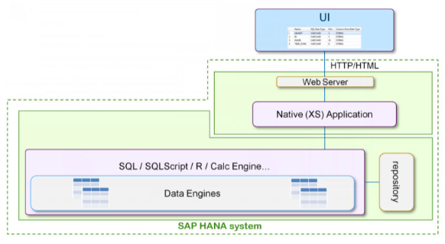
Native HANA Application
HANA Native applications are developed using web technologies (HTML5/CSS/JS, services, etc) and utilize the native web server on the HANA system. These apps are the focus of this curriculum.

Slide 7
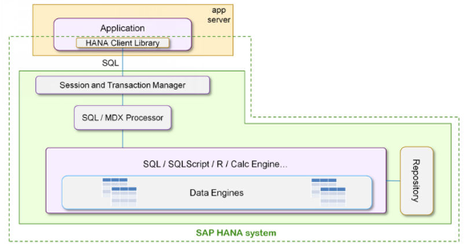
Non-Native HANA Applications
Non-native HANA applications utilize an external application server and can be developed using virtually any platform (ABAP, JAVA, .NET, etc.)

Slide 8
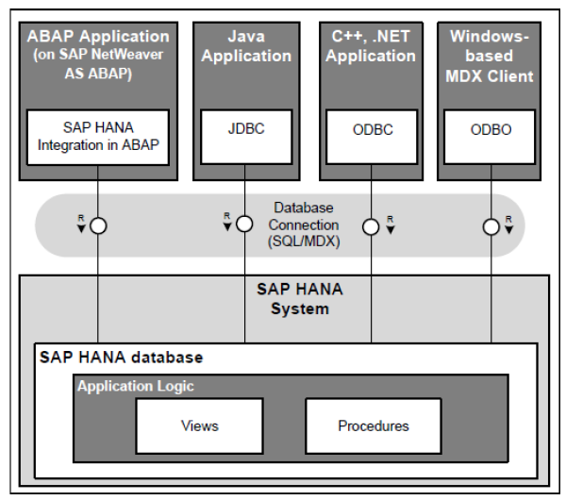
Non-Native HANA Applications
Non-native applications run on an external application server and access the HANA data model via standard client interfaces such as JDBC and ODBC.

Slide 9
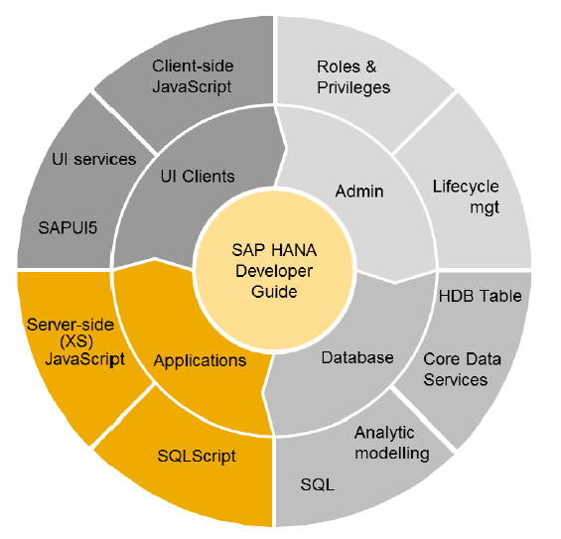
Elements of HANA Native Development
Client: HTML5, SAPUI5, JavaSript
Server: SQLScript, JavaScript
Database: SQL, Views, Core Data Services
Admin: Roles and Privileges

Slide 10
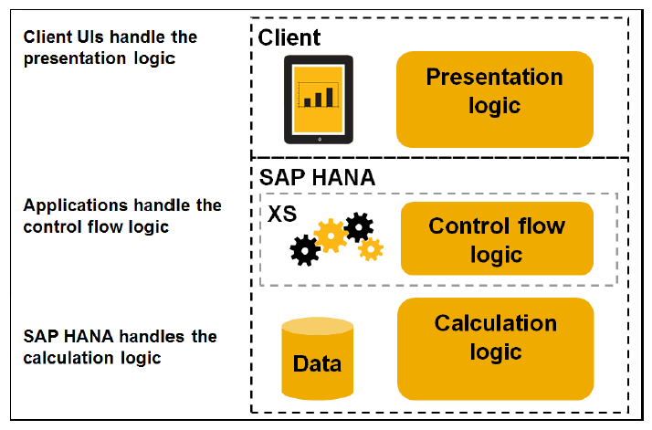
Native Application Tiers

Slide 11
HANA Development Environments

Slide 12
HANA Development Platforms
HANA Studio/Eclipse
Eclipse based
Cloud and On Premise
Web-Based Development Workbench
Browser based
Cloud and On Premise
WebIDE
Browser based
Currently only available on HCP

Slide 13
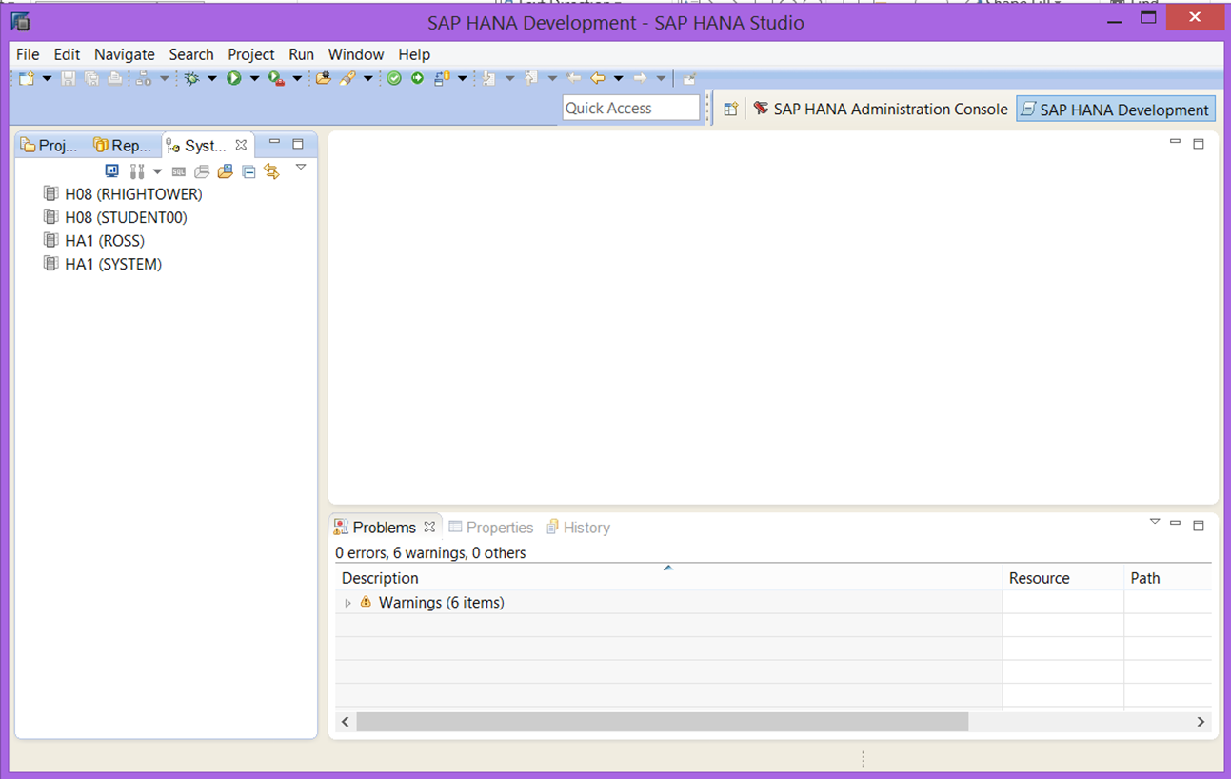
HANA Studio/Eclipse
Many people are already familiar with Eclipse.
JAVA, ABAP and HTML5
Currently, Eclipse offers a more polished experience than the web-based environments
Requires a local install and a relatively complicated check out procedure.
SAP has said they will direct the majority of their investment to the web-based platforms.

Slide 14
Eclipse Development Process
The developer can upload objects to the repository by Committing them
SAP HANA
SAP HANA Studio
Repository (Design-time)
Catalog (runtime)
Commit
Activate
Checkout
Repository objects can be checked-out and synchronized with a folder on the developer’s computer
Design-time objects in the repository are compiled into runtime objects in the Catalog by Activating them. The commit and activate steps can be combined in one step.
Development objects reside on the HANA system in the Repository

Slide 15
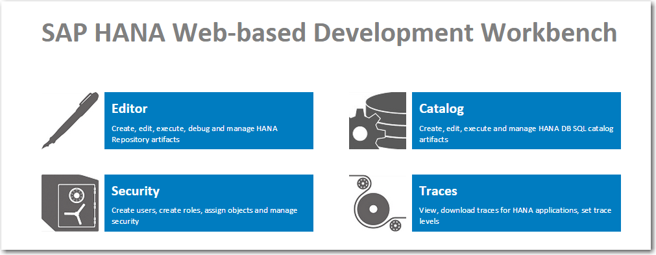
Web-Based Development Workbench
Still somewhat primitive but will improve as SAP has said they intend to invest in it and the WebIDE.
No local install and no complex checkout process.
HTML5, JavaScript, SQLScript and Calculation views only.

Slide 16
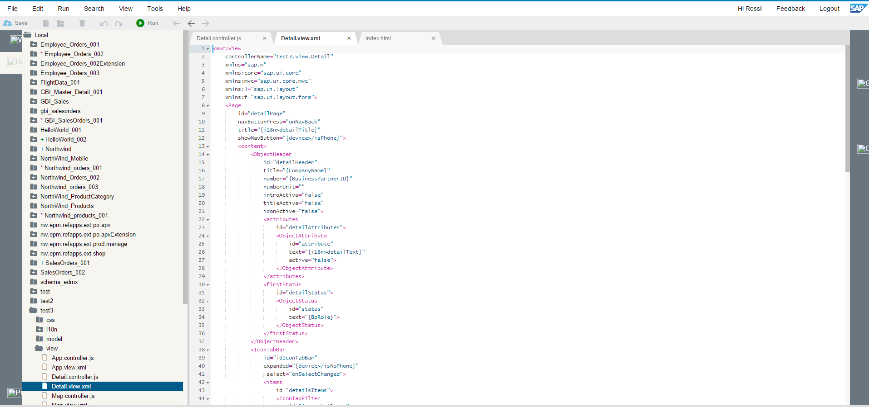
WebIDE
Only available on SAP HCP currently.
HTML5 only.
A more capable platform than the WDW with wizards and tools developers will appreciate.
Has a long way to go but it looks promising and being integrated with HCP so tightly is an advantage.
Frequently updated which can be good and bad.

Slide 17
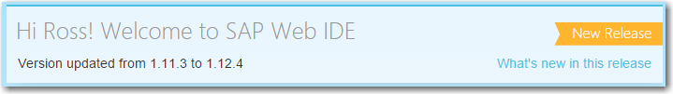
WebIDE
One drawback

Slide 18


Presentation Title Target Audience and Course Objectives
Target Audience
This course is intended for the following audiences:
Students who are studying
Everybody interested in the topic
Course Objectives
After completing this course, you will be able to:
Explain the concept
Describe the concept
List potential challenges and opportunities
Describe the components
Explain the manufacturing scenario for
Describe basics
Execute manufacturing scenario
evaluate performance and results

Slide 19
Thank you
Contact information:
F name MI. L name
Title
Address
Phone number

